Slide 1
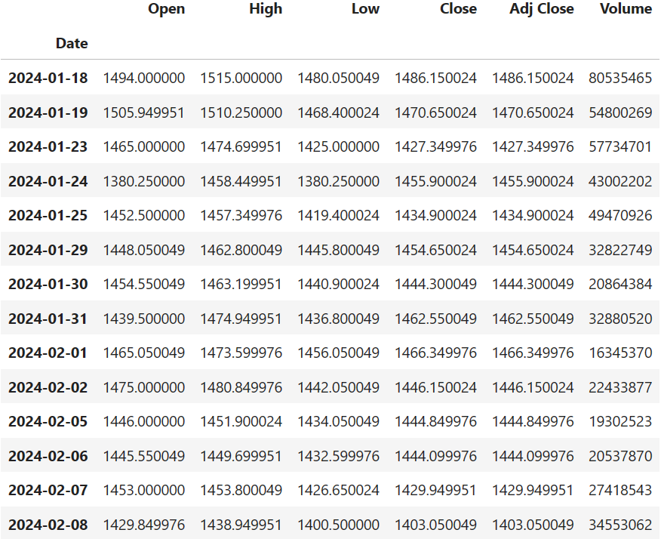
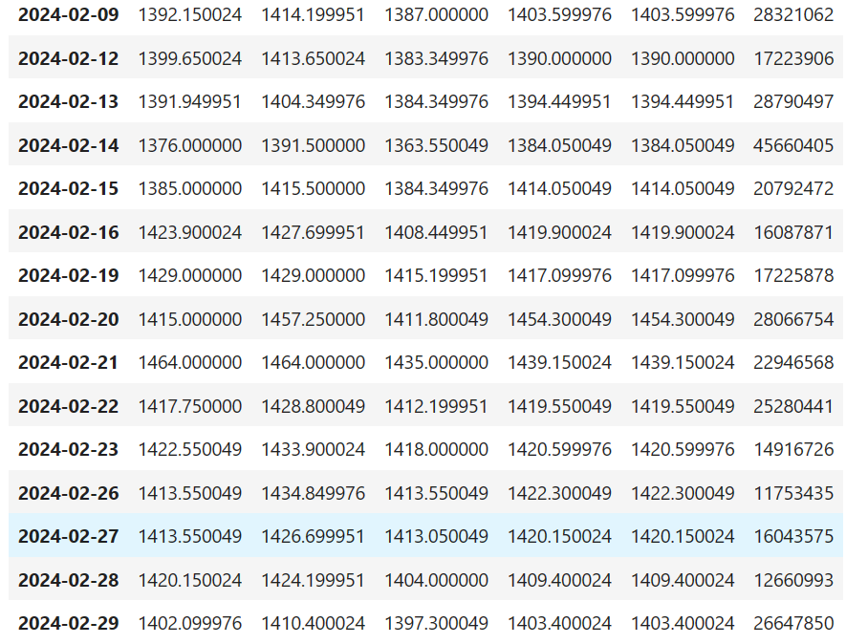
STOCK MARKET PREDICTION
Company Name – HDFC BANK
Algorithm Used : Linear Regression, Support Vector Machine, KNN, DT, Random Forest, LSTM
Features Used : Open, High, Low, Close
Input Data – (4 week) (Only working days included)

Slide 2
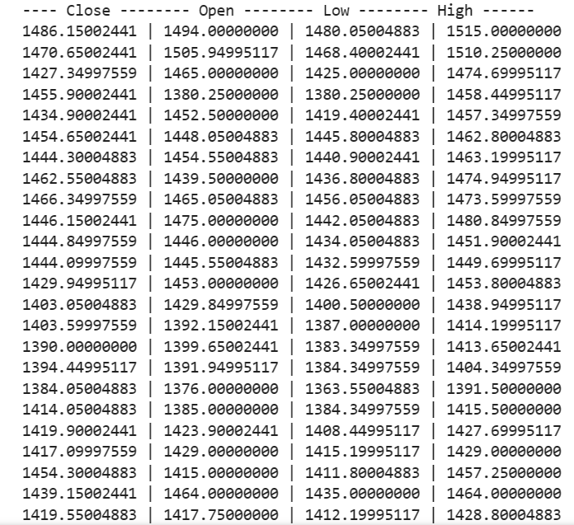
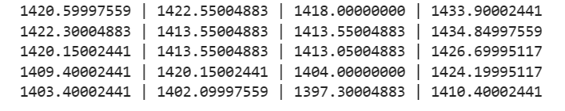

Slide 3
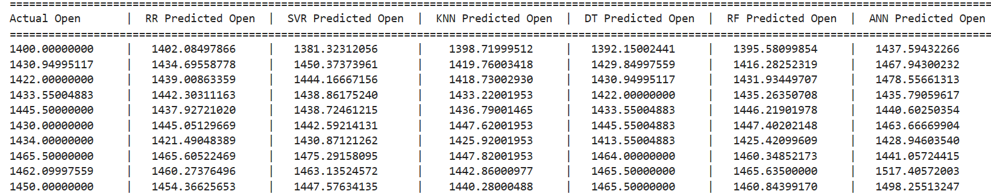
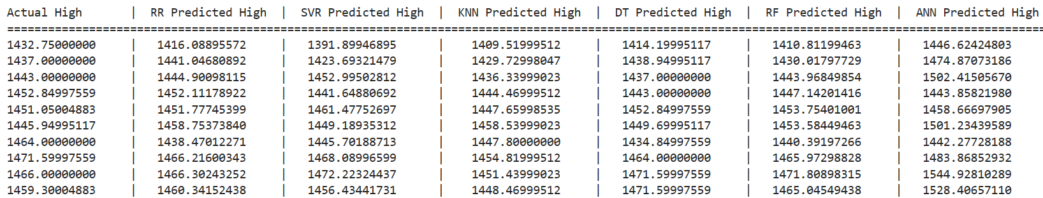
COMPARED ACTUAL AND PREDICTED PRICES
OPEN
HIGH

Slide 4
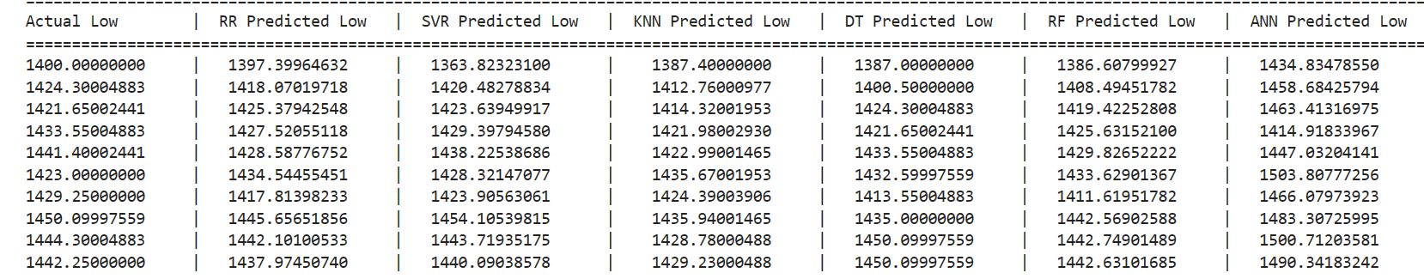
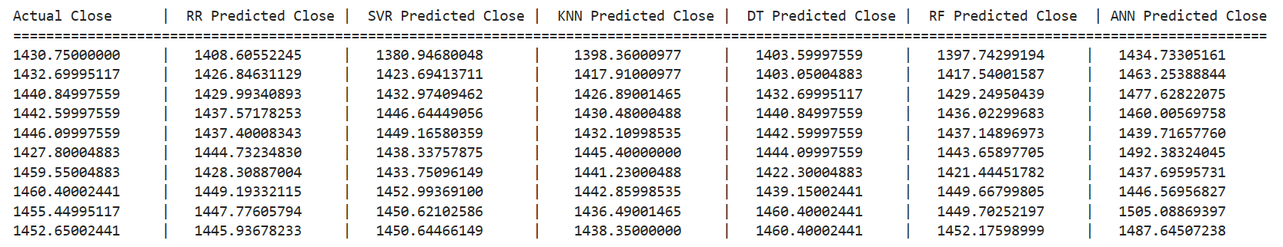
COMPARED ACTUAL AND PREDICTED PRICES
LOW
CLOSE

Slide 5
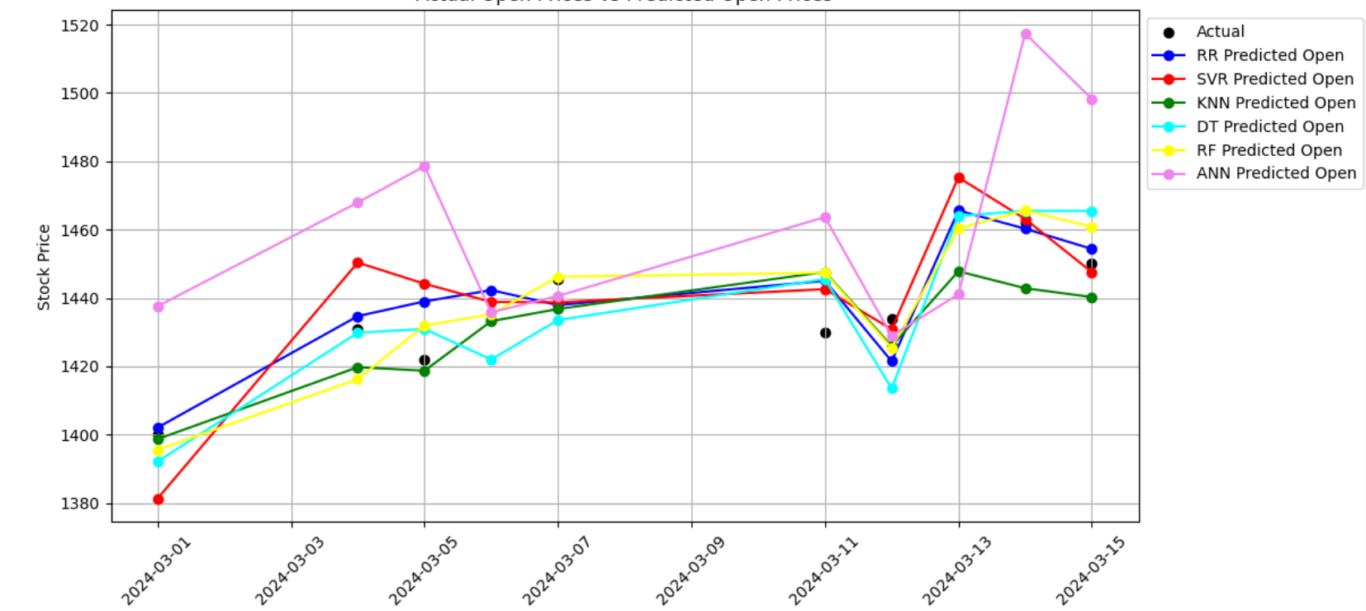
OPEN PRICES

Slide 6
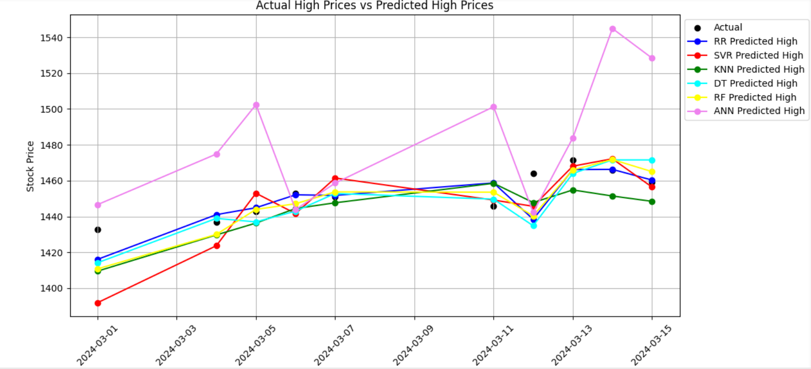
HIGH PRICES

Slide 7
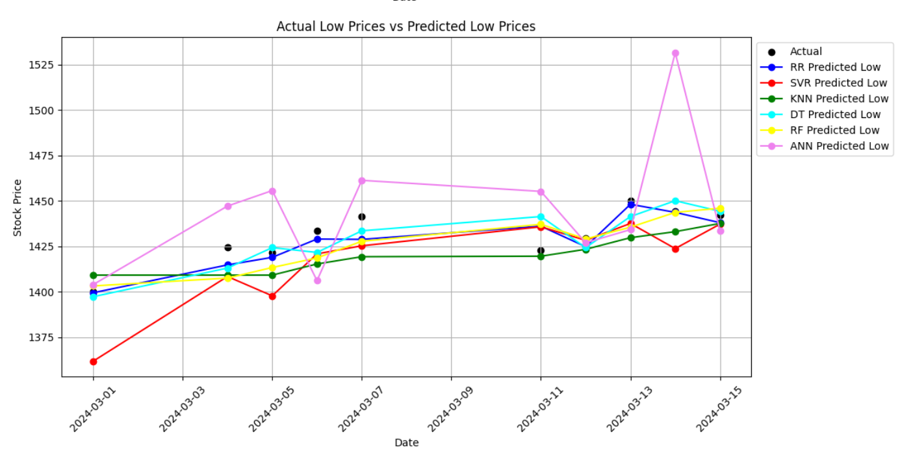
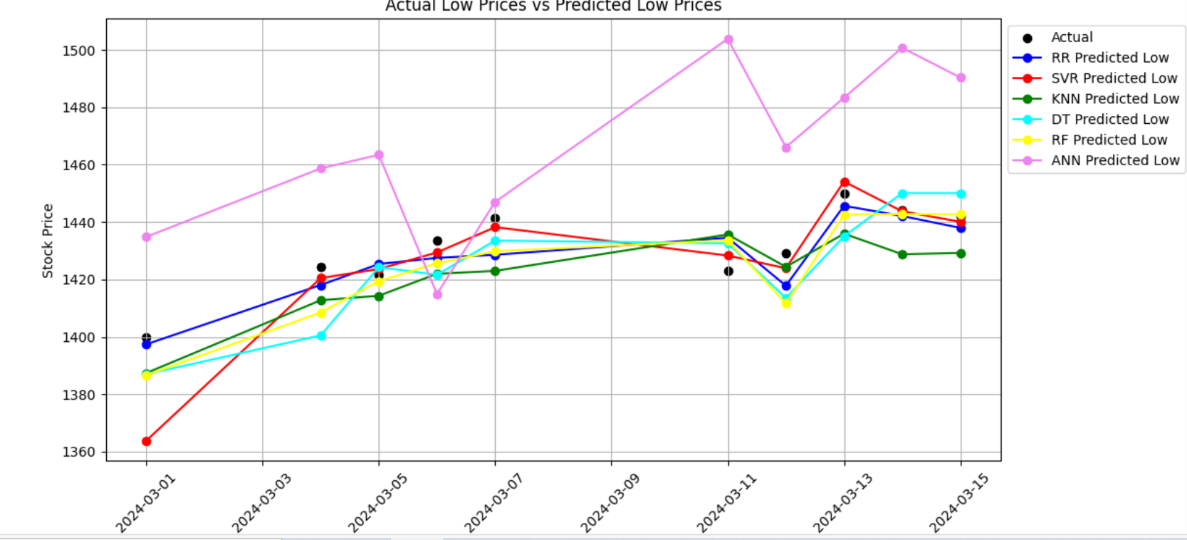
LOW PRICES

Slide 8
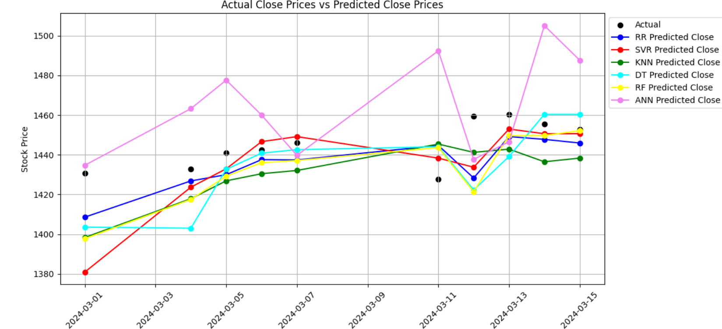
CLOSE PRICE

